Slide 1
“Homemade” Machine Learning Models
Philbert Fan, Michelle Ly, Harry Kong, Daniel Perez, Kyle He, Bernice Wong, Dylan Aubrey, Sophia Knapp

Slide 2

Machine Learning Algorithms Implemented
Linear Regression
K-Nearest Neighbors Regression
Decision Tree Regression
Random Forest Regression
Gradient Boosting Regression
We evaluated all of our models using the following metrics:
R², measures how well a model explains the variability of the target variable, closer to 1 the better
MAE (Mean Absolute Error), measures how far off the model’s predictions are from the actual values on average, lower this value is the better
Goal with our Dataset: To Predict Catch Rate

Slide 3


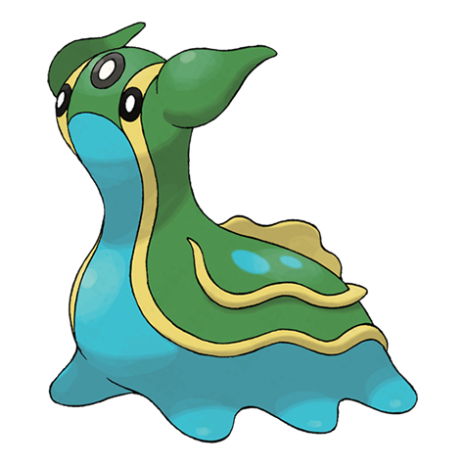
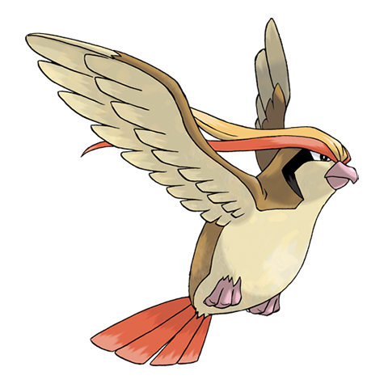
Data Exploration
721 rows, 22 columns
Most common type- Water (Ground)
Most common second type - Flying
Most stats maxed out at 165
Defense being an exception maxing out at 230
Most common body type- Bipedal & tailed
Catch rate varied strongly across different Pokemon body styles
Total stats had the highest correlation with catch rate
Special Attack had highest individual stat correlation
Notes:
Total stats highest correlation out of the potential stat groups/not including body types & characteristics
Could change side to some water & flying type pokemon

Slide 4
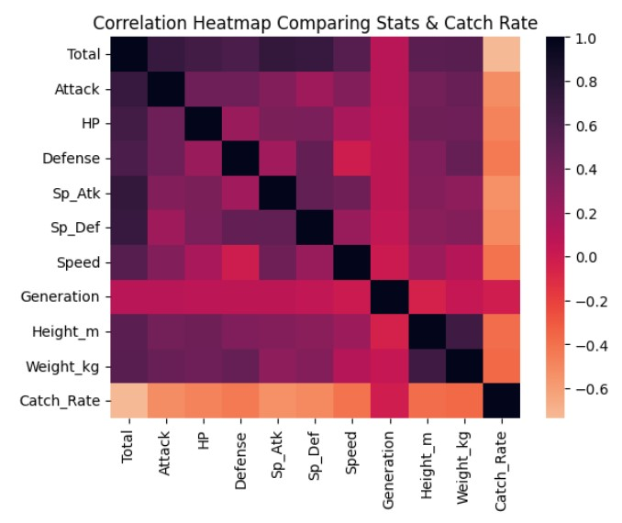
Visualization
Correlation Coefficient Heatmap of Stats & Catch Rate
How related is x variable to y variable?
Interesting Characteristics
Generation has little correlation across all variables
Small negative correlation between Defense & Speed
Positive correlation around Total stats and Height/Weight
Defense also has a positive correlation with Weight
Total has the highest correlation with Catch Rate
All negative correlations between stats and Catch Rate
Notes:
Stronger positive correlations between stats & total (sense makes) + stronger positive correlation between height & weight (also makes sense)

Slide 5
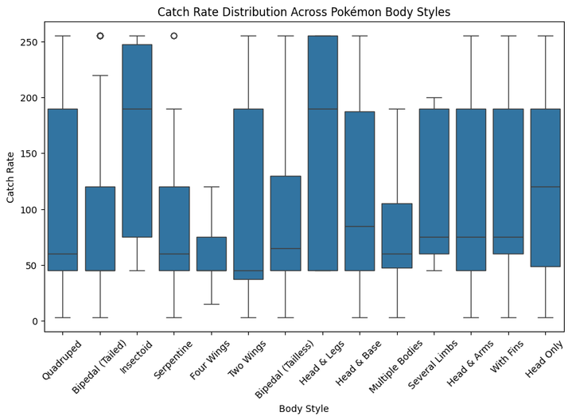
Visualization
This plot measures the catch rate distribution among different pokemon body styles.
It informs us about the median catch rate of of each body style.
Median values are helpful since they are more robust and less prone to skew from outliers.
Insectoid and Head & Leg Pokemon have a higher median catch rate than all other body styles.
Bipedal tailed, four-winged and two-winged pokemon have the lowest median catch rates.

Slide 6
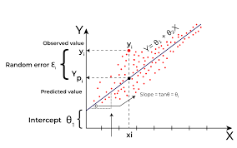


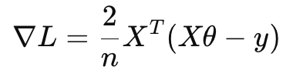
Linear Regression
What is Linear Regression?
Fits a linear function:
Goal is to minimize the error between predictions and actual values
Can have multiple variables in the linear equation
Methods are a closed-form solution or using Gradient Descent
How was Linear Regression Implemented in Our Project?
Batch Gradient Descent was used here using only NumPy
Updates where
Homemade Model vs. Sklearn Model Comparison
Sklearn Linear Regression had the exact same performance
Sklearn Linear Regression uses OLS closed-form solution while ours used Gradient Descent

Slide 7
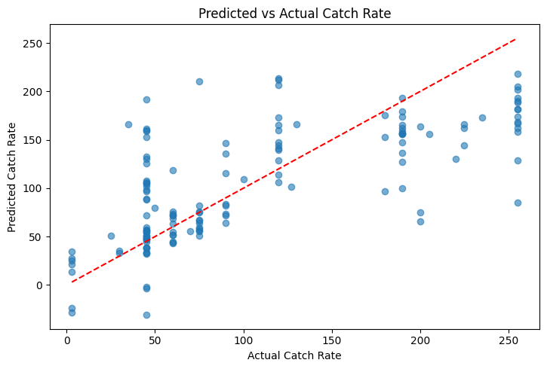
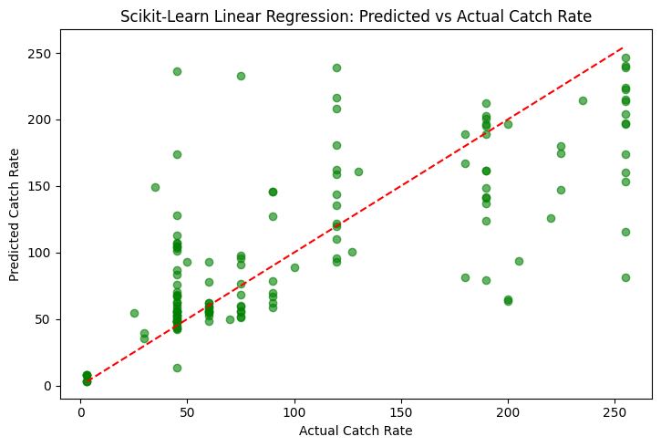
Linear Regression
Homemade Model:
MAE: 40.7432 | R²: 0.4912
Sklearn Model:
MAE: 40.7432 | R²: 0.4912
Homemade Model
Sklearn Model

Slide 8
K-Nearest Neighbors Regression
What is K-Nearest Neighbors Regression?
Predicts the target value for a new point by using target values of its k nearest neighbors
Lazy learning algorithm that is sensitive to feature scaling so standardization is crucial
How was KNN Regression Implemented in Our Project?
Using only NumPy, the KNN Regression algorithm we made uses Euclidean distance
Euclidean distance:
Takes the average of the k nearest points to predict the new point
Homemade Model vs. Sklearn Model Comparison
Model tuning found that when k is 8 the model has the best performance for our problem
Sklearn KNN Regression had the same performance
Sklearn KNN Regression also uses Euclidean distance by default

Slide 9
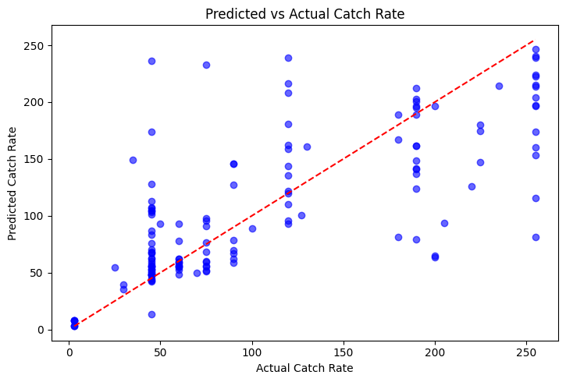
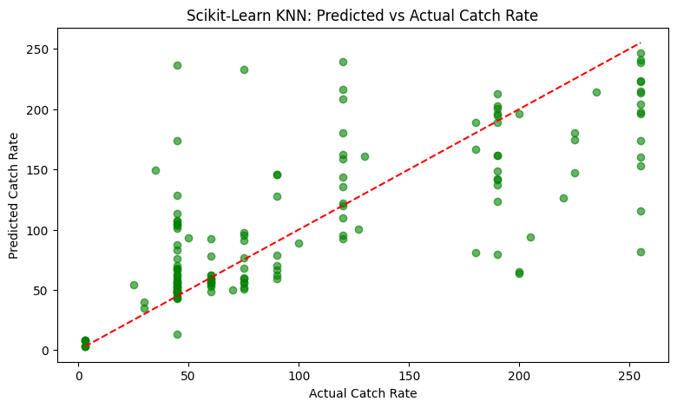
K-Nearest Neighbors Regression
Homemade Model:
MAE: 34.7943 | R²: 0.5412
Sklearn Model:
MAE: 34.7943 | R²: 0.5412
Homemade Model
Sklearn Model

Slide 10
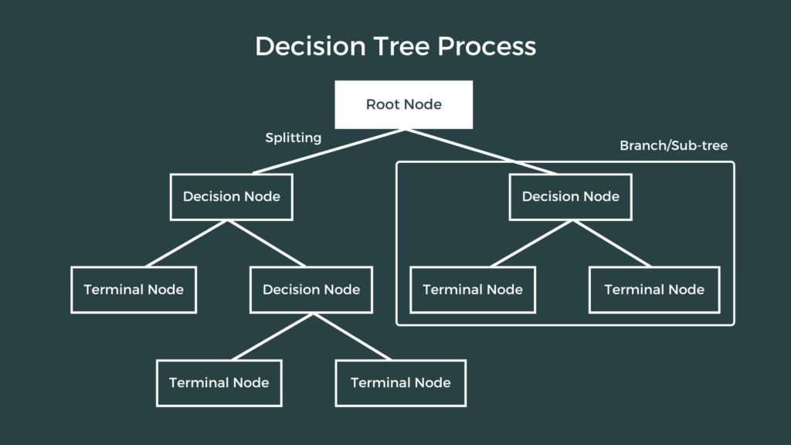
Decision Tree Regression
What is Decision Tree Regression?
Predicts continuous outcomes by breaking down data into smaller and smaller subsets
A particular factor is chosen to split the data on and then the data split into two groups based off of a threshold value (usually the mean)
How was Decision Tree Regression Implemented in Our Project?
Use NumPy to create Node class and generate decision tree
Included arguments for max depth, minimum samples required to split, and minimum samples per leaf
Included variance reduction and best_split functions to determine which split will result in the largest decrease in variation and which factor to split on
Homemade Model vs. Sklearn Model Comparison
The two models had very similar performance
Both had fairly low R^2 and MSE, indicating that Decision Tree Regression wouldn’t be the best model for this task

Slide 11
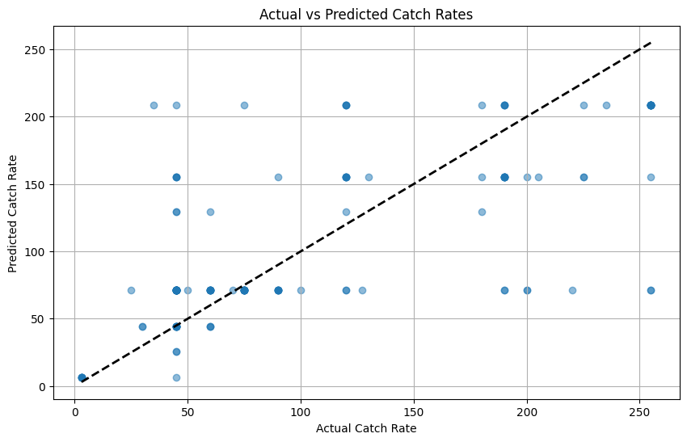
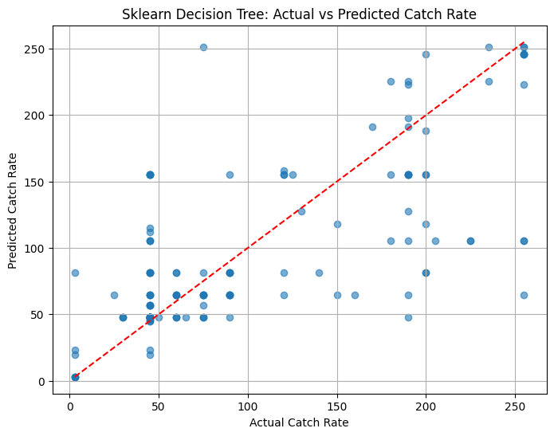
Decision Tree Regression
Homemade Model:
MAE: 38.20 | R²: 0.489
Sklearn Model:
MAE: 34.42 | R²: 0.493
Homemade Model
Sklearn Model

Slide 12
Random Forest Regression
What is Random Forest Regression?
An ensemble of many decision trees trained on random subsets of data
Predicts by averaging outputs from all trees OR majority vote
Handles nonlinear relationships and interactions between variables well, with minimal tuning needed.
How was Random Tree Regression Implemented in Our Project?
2 sources of randomness: Bootstrapping & Random feature selection
Predictions were averaged across all trees to generate the final output.
Metrics used: Mean Absolute Error (MAE) and R²
Homemade Model vs. Sklearn Model Comparison
Both models achieved similar performance: our homemade model showed slightly better MAE and R²

Slide 13
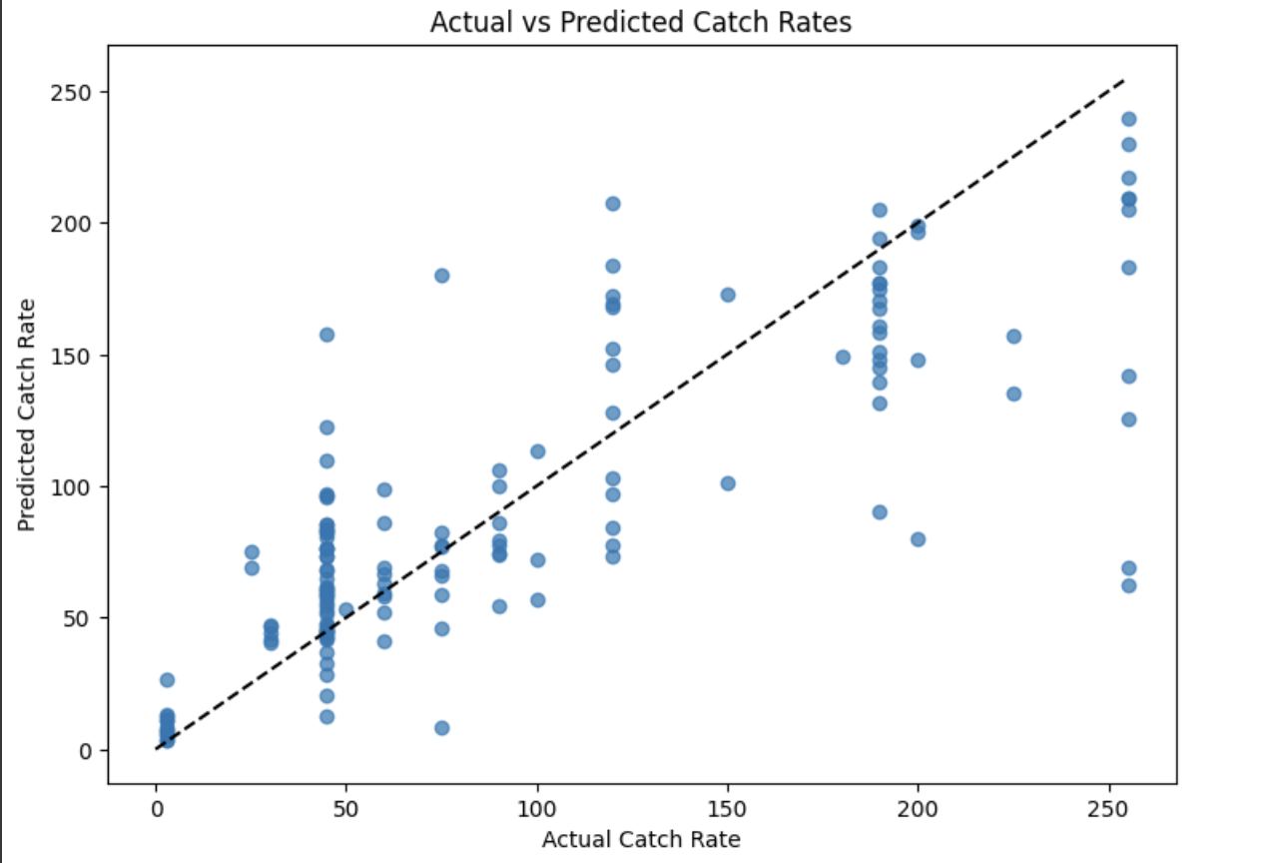
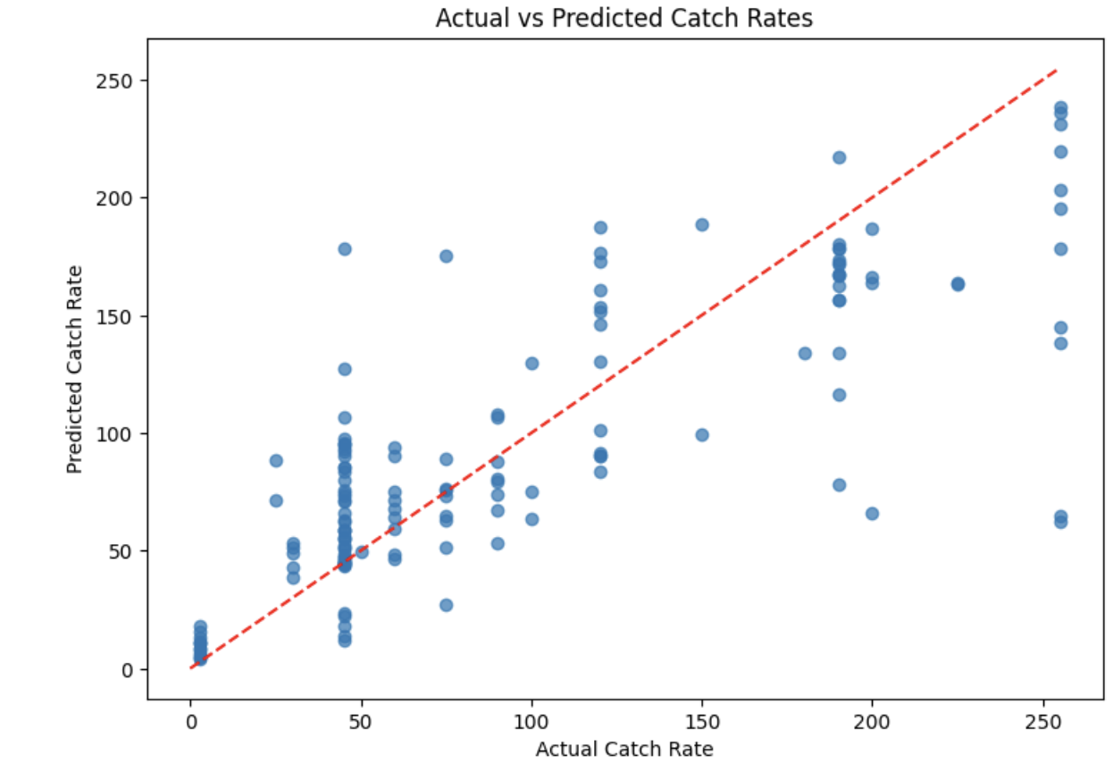
Random Forest Regressor
Homemade Model:
MAE: 29.89 | R²: 0.649
Sklearn Model:
MAE: 30.37 | R²: 0.637
Homemade Model
Sklearn Model

Slide 14
Gradient Boosting Regression
What is Gradient Boosting Regression?
An ensemble method that combines many weak learners, in this case shallow trees, to form a strong predictor
Trains each weak learner on the residual errors of the previous model so each model corrects the errors of the previous model
Uses Gradient Descent to minimize a loss function, which is how well the model predictions match the actual values
How was Gradient Boosting Regression Implemented Here?
Used a custom DecisionStumpRegressor, which is a 1-level decision tree, built only with NumPy
Initial prediction is the mean of y
For each iteration residuals were computed and then a DecisionStumpRegressor model was fit on the residuals which would update the predictions
Stops after a fixed number of iterations controlled by a hyperparameter ‘n_estimators’
Homemade Model vs. Sklearn Model Comparison
Both models have very similar R² (0.54), so they explain about the same amount of variance in the data.
Sklearn has a slightly better MAE (34.68 vs 36.86), meaning its average absolute error is slightly smaller.
Our homemade model’s performance is close to Sklearn’s, which is impressive given that sklearn uses more advanced tree algorithms.

Slide 15
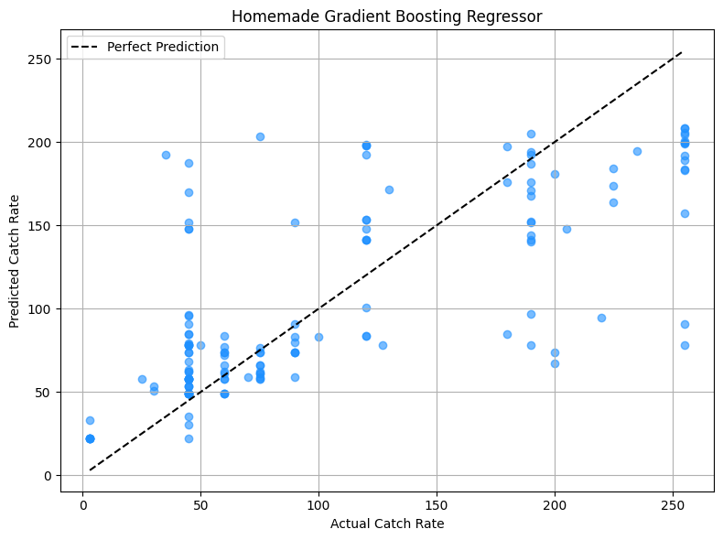
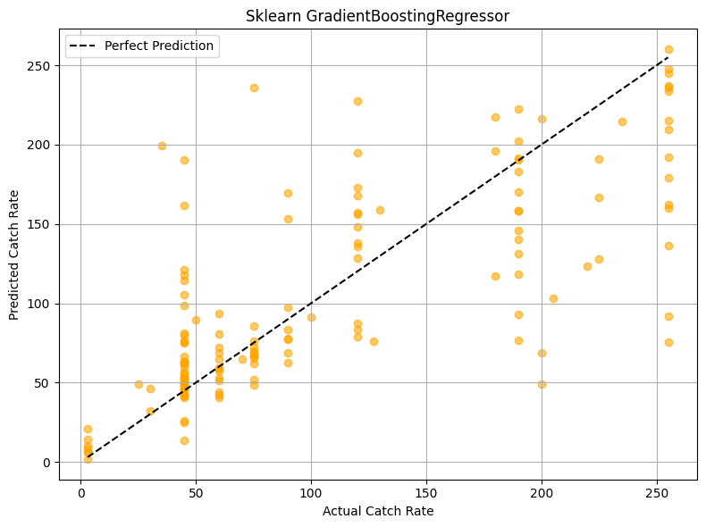
Gradient Boosting Regressor
Homemade Model:
MAE: 36.86 | R²: 0.54
Sklearn Model:
MAE: 34.52 | R²: 0.54
Homemade Model
Sklearn Model

Slide 16
Best Model for Our Dataset
Random Forest Regressor performed the best out of all our models
Random Forest worked the best because it:
Aggregates predictions of many decision trees built on different random subsets of the data, reducing variance
Captures complex patterns and feature interactions better than simple linear models
Is less sensitive to noise
Why did the other models perform worse?:
Linear regression: Assumes linear relationship and struggles with complex interactions
K-nearest neighbors: While good for local patterns, is sensitive to noisy data
Decision tree: May overfit training data, leading to more errors
Gradient boosting regression: Use of stumps may be too weak to capture complex patterns
Notes:
Captures complex patterns and feature interactions better (than simple linear models)

Slide 17

Thank You!
Implementation Code
Dataset
Machine Learning Algorithms Conceptual Document

